Slide 1

Netflix Big Data Analytics Project
Scalable Exploration and Insight Extraction from Streaming Content
Giuseppe Nato 2023/2024

Slide 2


Introduction
Dataset Description
Preliminary Analysis
Sandbox Analysis
Spark Analysis
Results and conclusions
1
2
3
4
5
6
Data source
Data Structure
Data Preparations
Hypothesis Formulation
Metrics Definition
Sandbox Extraction
EDA
Descriptive Analysis
Inferential Analysis
Hypothesis Testing
Objectives
Technologies Used
Architecture Description
Reprocessing of Complete Data
Final Hypothesis Validation
Main Insights Obtained
Pratical implications
Giuseppe Nato
492956

Slide 3
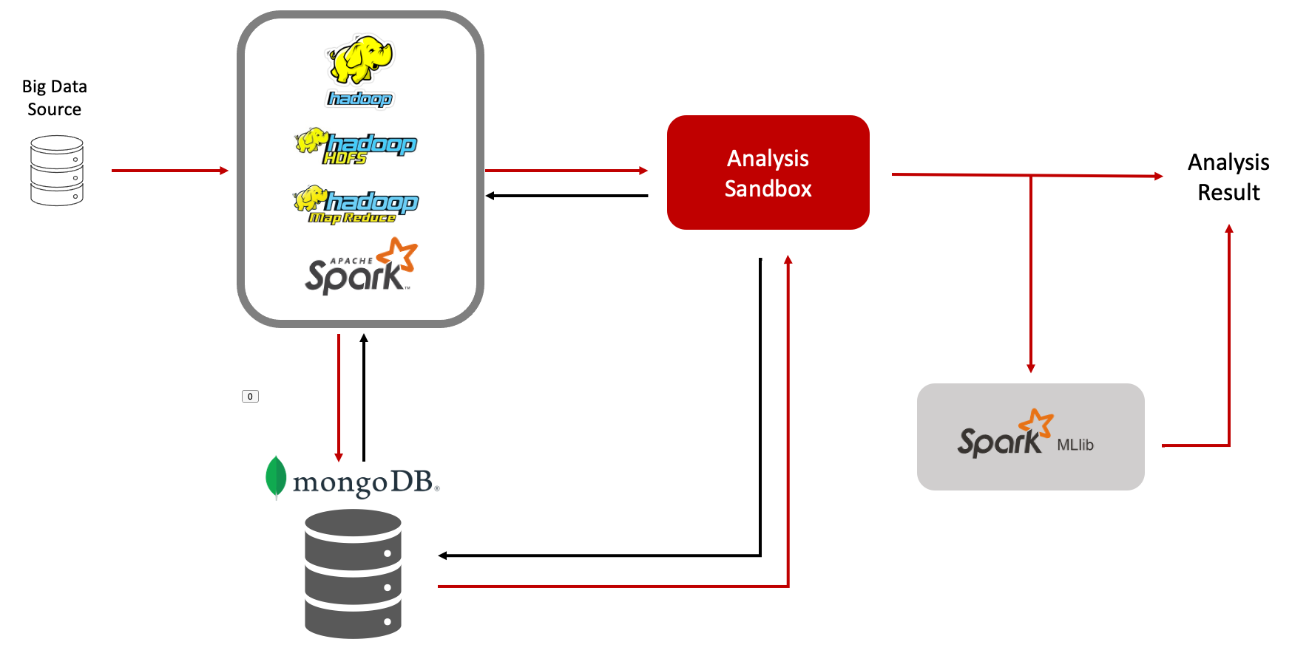
INTRODUCTION- ARCHITECTURE DESCRIPTION
1
The project aims to provide useful insights on Netflix content through detailed analysis and to develop a robust and scalable solution in a Big Data context, using technologies such as Hadoop, Spark, and MongoDB.
The project uses Hadoop and Spark to load and preprocess data and extract a sandbox for data analysis with standard python libraries, MongoDB for the data warehouse and HDFS for the datalake.
Big Data
Technologies
Big Data Technologies Used :
Hadoop :
HDFS (Hadoop Distributed File System)
MapReduce
Apache Spark :
PySpark
SparkMl
MongoDB
Python libraries for data analysis:
Numpy
Matplotlib
Pandas
Scikit-learn
Giuseppe Nato
Academic Year 2023/2024
492956

Slide 4
DATASET DESCRIPTION
2
ID: Unique identifier of the content.
Title: Title of the movie or TV series.
Type: Type of content (Movie or TV Series).
Description: Brief description of the content.
Release Year: Year of release.
Age Certification: Age certification.
Runtime: Duration of the content in minutes.
Genres: Genres associated with the content.
Production Country: Country of production.
Seasons: Number of seasons (for TV series).
IMDB Score: IMDB score.
IMDB Votes: Number of votes on IMDB.
TMDB Popularity: Popularity on TMDB.
TMDB Score: Score on TMDB.
The dataset used in the project is titled "Netflix TV Shows and Movies." This dataset was developed to catalog all the shows available on Netflix's streaming platform and to facilitate data analysis to uncover interesting insights. The data, which includes information specific to the United States, was collected in July 2022.
The dataset consists of two sub-datasets: one with the titles ( "Titles" ) and one with the cast information ( "Credits" ) for each title.
"Titles" contains movie and show titles available on Netflix, described in 15 columns that contain various details about each title:
person_ID: Identifier of the person on JustWatch.
id: Identifier of the title on JustWatch.
name: Name of the actor or director.
character_name: Name of the character.
role: Role (actor or director).
"Credits" contains information for actors and directors featured in Netflix titles, organized in five columns that contain:
Giuseppe Nato
Academic Year 2023/2024
492956

Slide 5
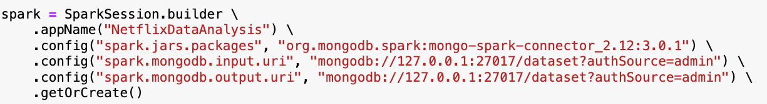
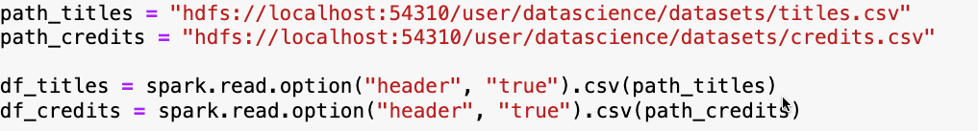
PRELIMINARY ANALYSIS
3
Loading Data into Hadoop HDFS
The project began by loading the dataset into Hadoop HDFS to ensure scalability and efficient data distribution across a machine cluster in a Big Data context.
Load the titles.csv into HDFS
hadoop fs -put /home/datascience/titles.csv /user/datascience/datasets/
Load the file credits.csv into HDFS
hadoop fs -put /home/datascience/credits.csv /user/datascience/datasets/
Creating the Spark Session
The next step is to create a Spark session to connect to HDFS and retrieve the datasets. This is crucial for conducting data analysis in a distributed and scalable environment typical of Big Data contexts.
Reading Files from HDFS
Once the Spark session is created, we specify the paths of the CSV files on HDFS and import the data into Spark DataFrames to start our analysis.
Giuseppe Nato
Academic Year 2023/2024
492956

Slide 6
HYPOTHESES AND EVALUATION METRICS
3
Hypotheses
Our analysis will be conducted by testing and trying to refute the following hypothese
H1: Movies with a longer runtime tend to have higher scores.
H2: Movies with a larger cast are generally more highly rated.
H3: Movies that include specific genres (e.g., action or drama) perform better in terms of scores.
H4: Movies with more restrictive age certifications have higher scores.
H5: Movies produced in more countries tend to have higher scores.
H6: Newer movies have different rating trends compared to older movies, with possible annual variations.
H7: The presence of certain keywords in Netflix movie titles is positively correlated with the success of the movie.
H8: The characteristics of a movie (runtime, genre, age certification, number of actors, IMDb score, popularity on TMDB, etc.) can be used to predict whether a movie will be successful or not.
Metrics
To prove or refute our hypotheses, we propose the following metrics:
Runtime: The duration of a movie in minutes. This metric is related to H1.
Average_Score: The average score of movies on IMDB and TMDB . It is linked to H1 and H4.
Cast_size: The number of main actors in a movie. It is linked to H2.
TMDB_Popularity: The measure of a movie's popularity on TMDB. It is linked to H2, H3, H5, and H6.
Genre: The genre or genres associated with a movie (action, drama, etc.). It is linked to H3.
Age_Certification: The age rating (G, PG, PG-13, R, NC-17) of a movie. It is linked to H4.
Num_production_countries: The number of countries involved in the production of a movie. It is linked to H5.
Release_Year: The year a movie was released. It is linked to H6.
Count_word: Keywords identified in the titles of movies on Netflix. It is linked to H7.
Success: The success metric indicates whether a movie is considered successful or not. It is linked H8
Giuseppe Nato
Academic Year 2023/2024
492956

Slide 7
DATA PREPARATION
3
Data Cleaning
After loading the data into a PySpark DataFrame, we cleaned it by checking for duplicates and missing values. This ensures the data is accurate, consistent, and ready for analysis.
Duplicate Values:
Both Dataframes do not contain duplicate values.
Missing Value:
In Titles, the fields with the most missing values are age certification, seasons, and IMDb score.
In Credits, the character field has many null values.
Missing Values
To handle missing data in Titles, we adopted several specific strategies to ensure the integrity and usefulness of the data:
The columns 'title', 'type', 'release_year', 'genres', 'production_countries', 'imdb_id', and 'runtime' contain crucial data. To avoid bias and ensure the integrity of the analyses, we decided to remove rows with missing values in these columns.
Description: For missing values, we imputed the text "No description available". This allows us to maintain the completeness of the dataset without compromising the analyses.
Age_certification: For missing values, we imputed the text "NR" (Not Rated). This choice was made because removing the rows would have significantly reduced the dataset size.
Seasons: We imputed 0 for movies and kept the existing number of seasons for TV series. This ensures accuracy in comparative analyses.
We removed rows with missing values for 'imdb_score', 'imdb_votes', 'tmdb_popularity', and 'tmdb_score' to ensure the reliability of the analyses.
This management allowed us to avoid introducing bias and ensure data integrity.
Giuseppe Nato
Academic Year 2023/2024
492956

Slide 8
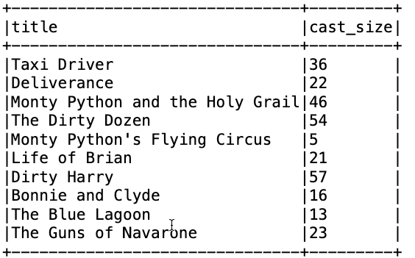
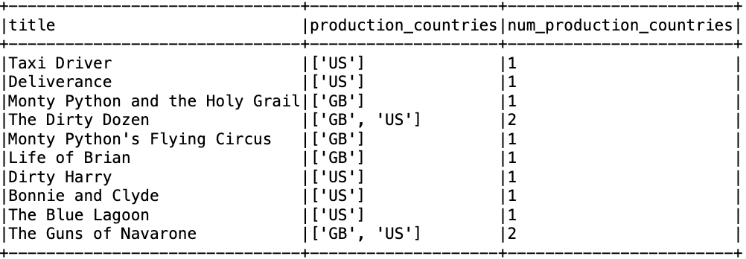
METRICS COMPUTATIONS
3
After cleaning the data and ensuring there were no missing values, we proceeded to calculate the necessary metrics to test our hypotheses.
Cast_size:
We calculated the number of cast members ("cast_size") for each title by filtering the data in Credits to include only cast members with the role "ACTOR" and non-null values. Subsequently, we aggregated the data to calculate the number of cast members for each movie. Finally, we merged the result with Titles to add the number of cast members to each title, handling any null values.
Num_production_countries
We calculated the number of production countries for each movie by adding a new column "num_production_countries" in the Titles DataFrame. This column contains the count of production countries for each title. To achieve this, we split the values in the "production_countries" column into an array and calculated the size of the resulting array.
Giuseppe Nato
Academic Year 2023/2024
492956

Slide 9
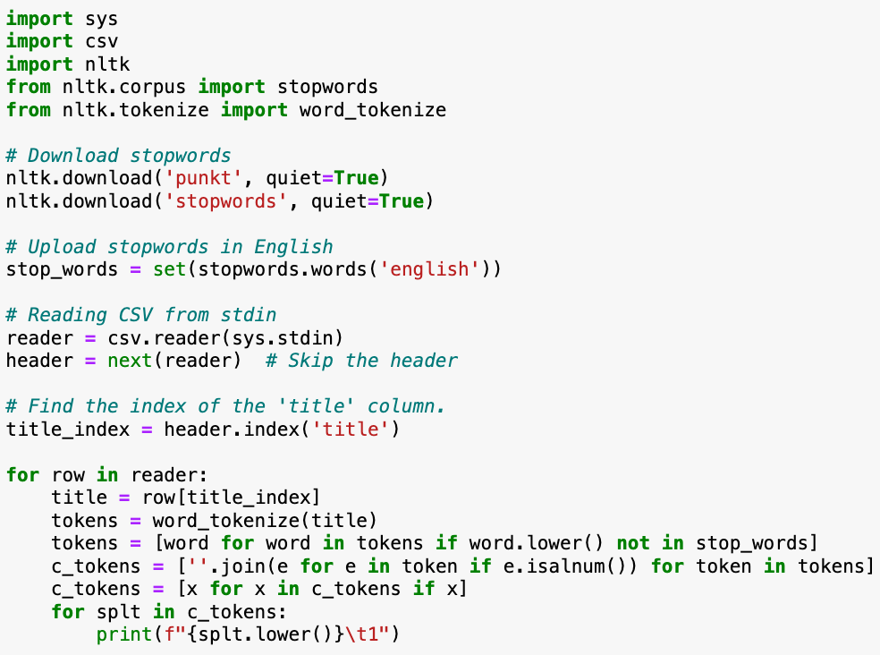
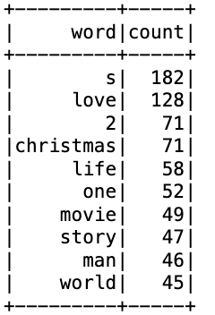
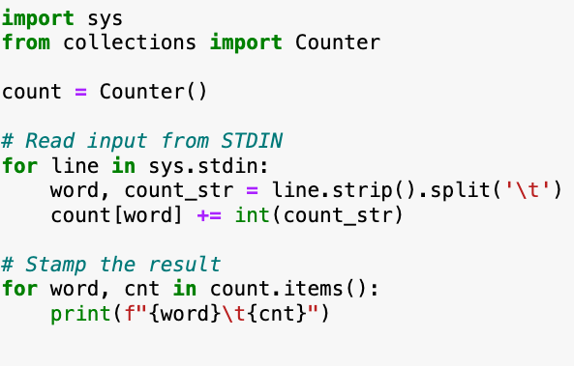
METRICS COMPUTATIONS
3
Count_word
We calculated "Count_word" by implementing a MapReduce job. This process consists of two phases: the Map phase and the Reduce phase.
The mapper reads the CSV file from stdin and performs several preprocessing operations. First, it tokenizes the movie titles using the word_tokenize module from NLTK. Next, it removes English stopwords and filters out non-alphanumeric characters from the remaining words. Each cleaned word is emitted as a key-value pair <word, 1>, representing the word and its single occurrence.
The reducer receives the output from the mapper, the key-value pairs <word, 1>, and aggregates them. Using a Counter data structure, the reducer sums the counts for each word. Finally, the reducer emits the aggregated result as key-value pairs <word, count>, where count represents the total number of occurrences of each word in the movie titles.
Giuseppe Nato
Academic Year 2023/2024
492956

Slide 10
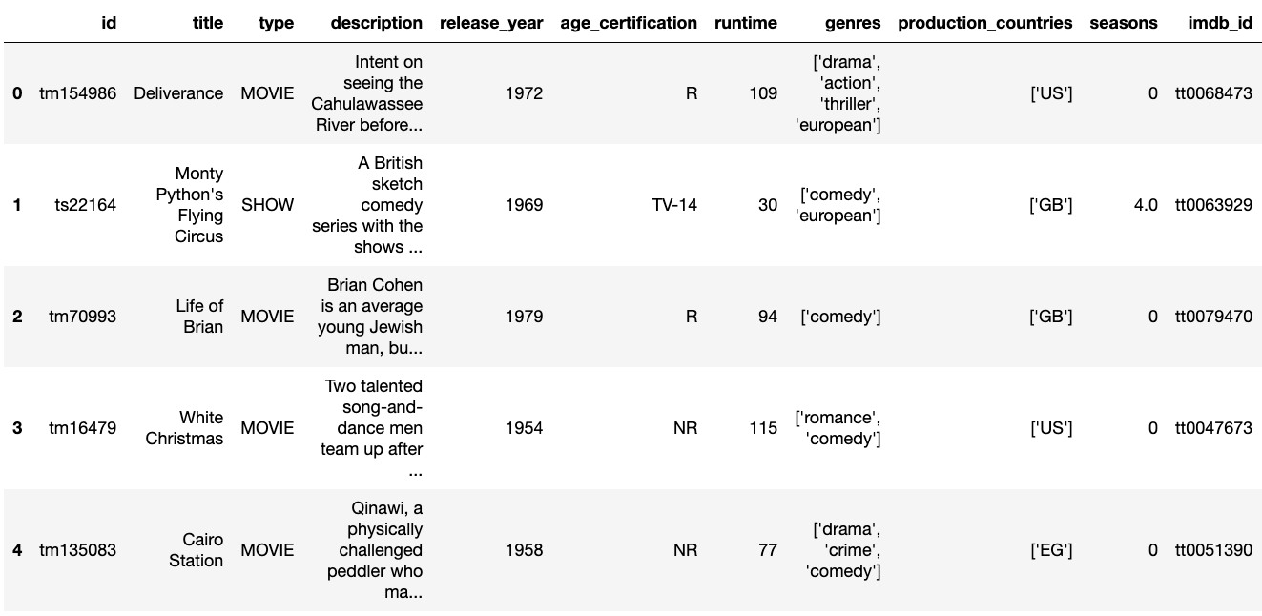
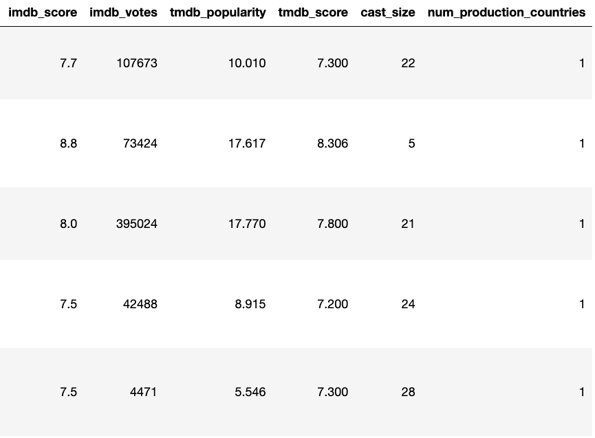
SANBOX EXTRACTIONS
After cleaning the dataset and compute the metrics, we used MongoDB for long-term storage. Specifically, we stored:
The cleaned dataset.
The output of the MapReduce job.
A sandbox as a representative sample equal to 50% of the data, to be used for future analyses.
We named the dataset Netflix, which includes three distinct collections. :
Films
Sandbox
CountWord
We used PyMongo to connect to MongoDB and retrieve the data from the Sandbox collection. This data was then converted into a Pandas DataFrame to facilitate analysis.
Giuseppe Nato
Academic Year 2023/2024
492956

Slide 11
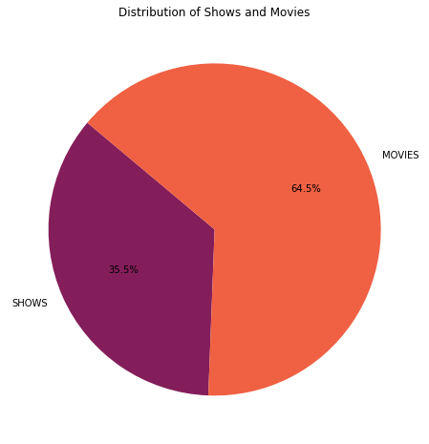
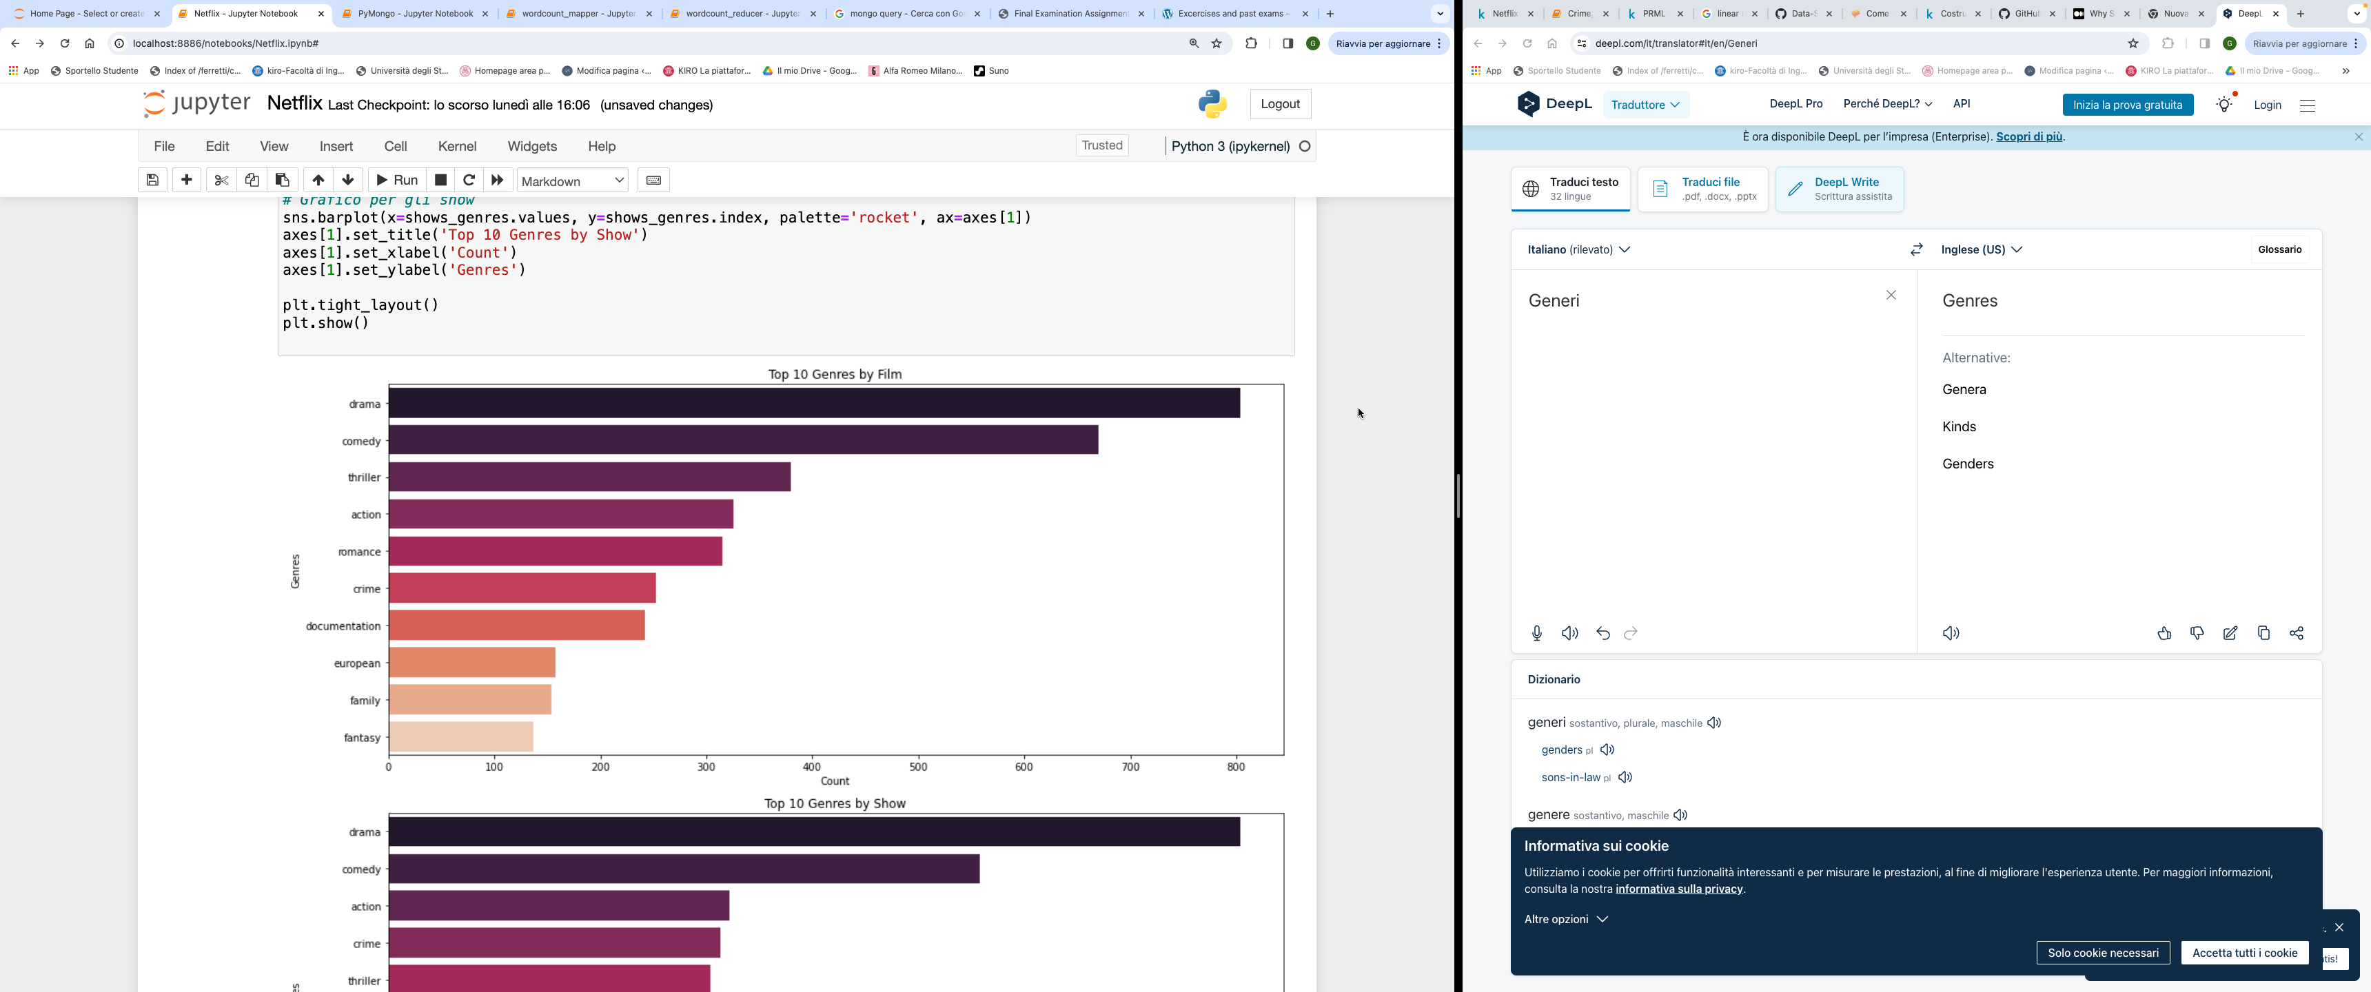
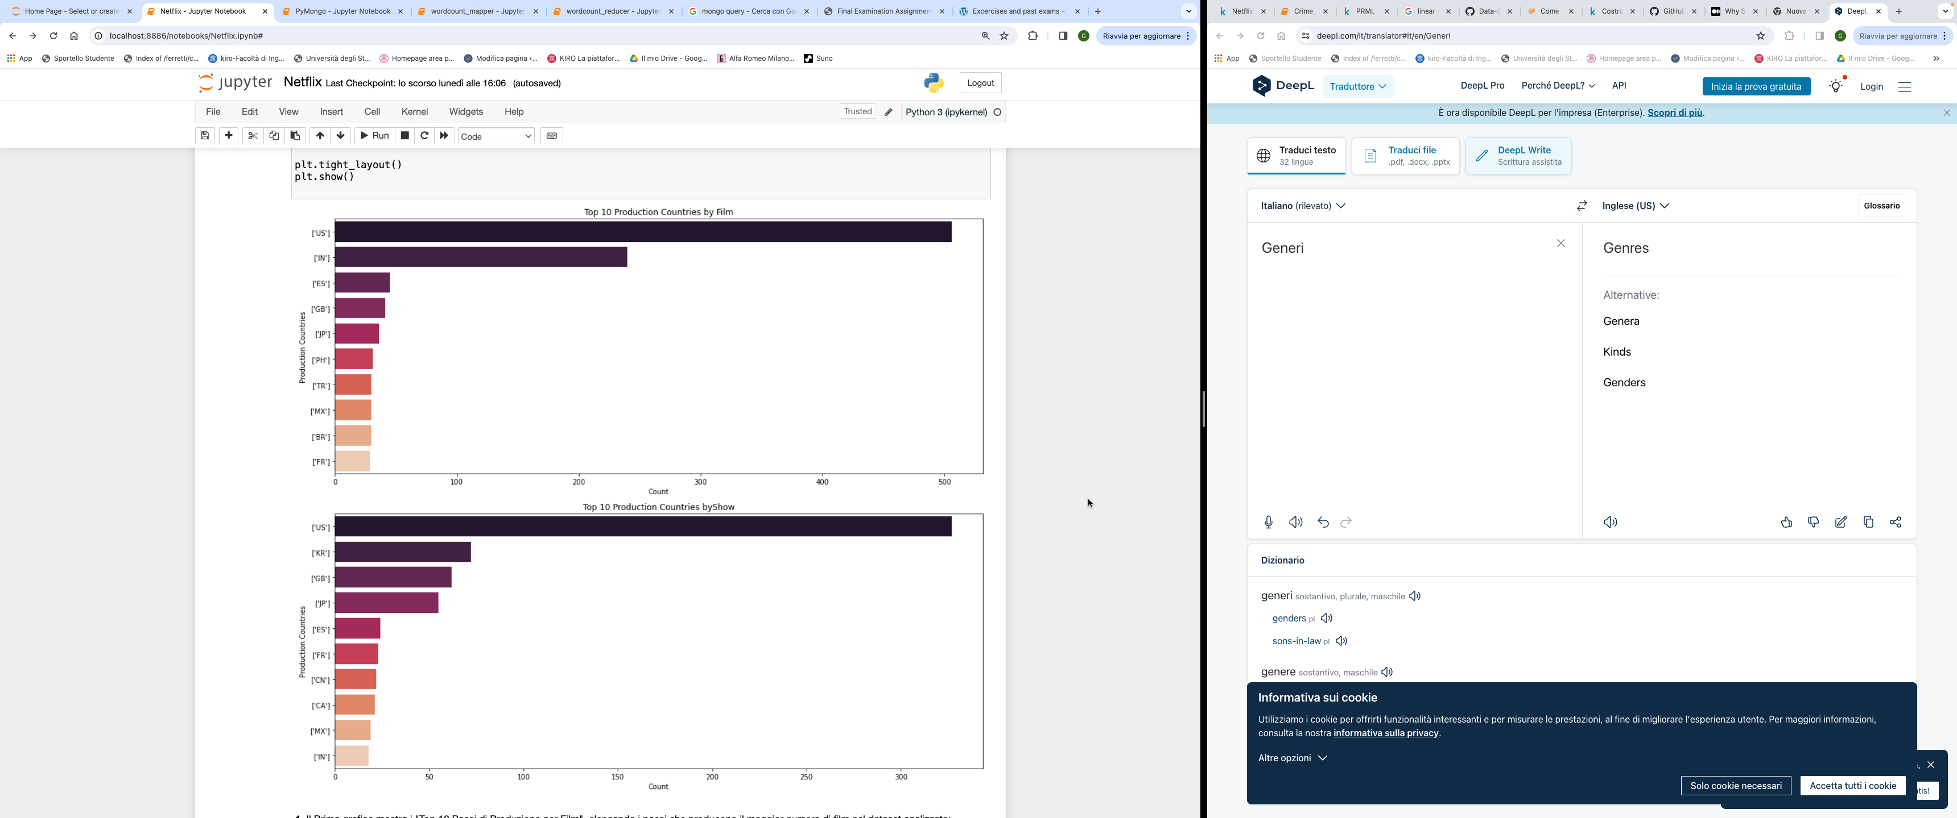
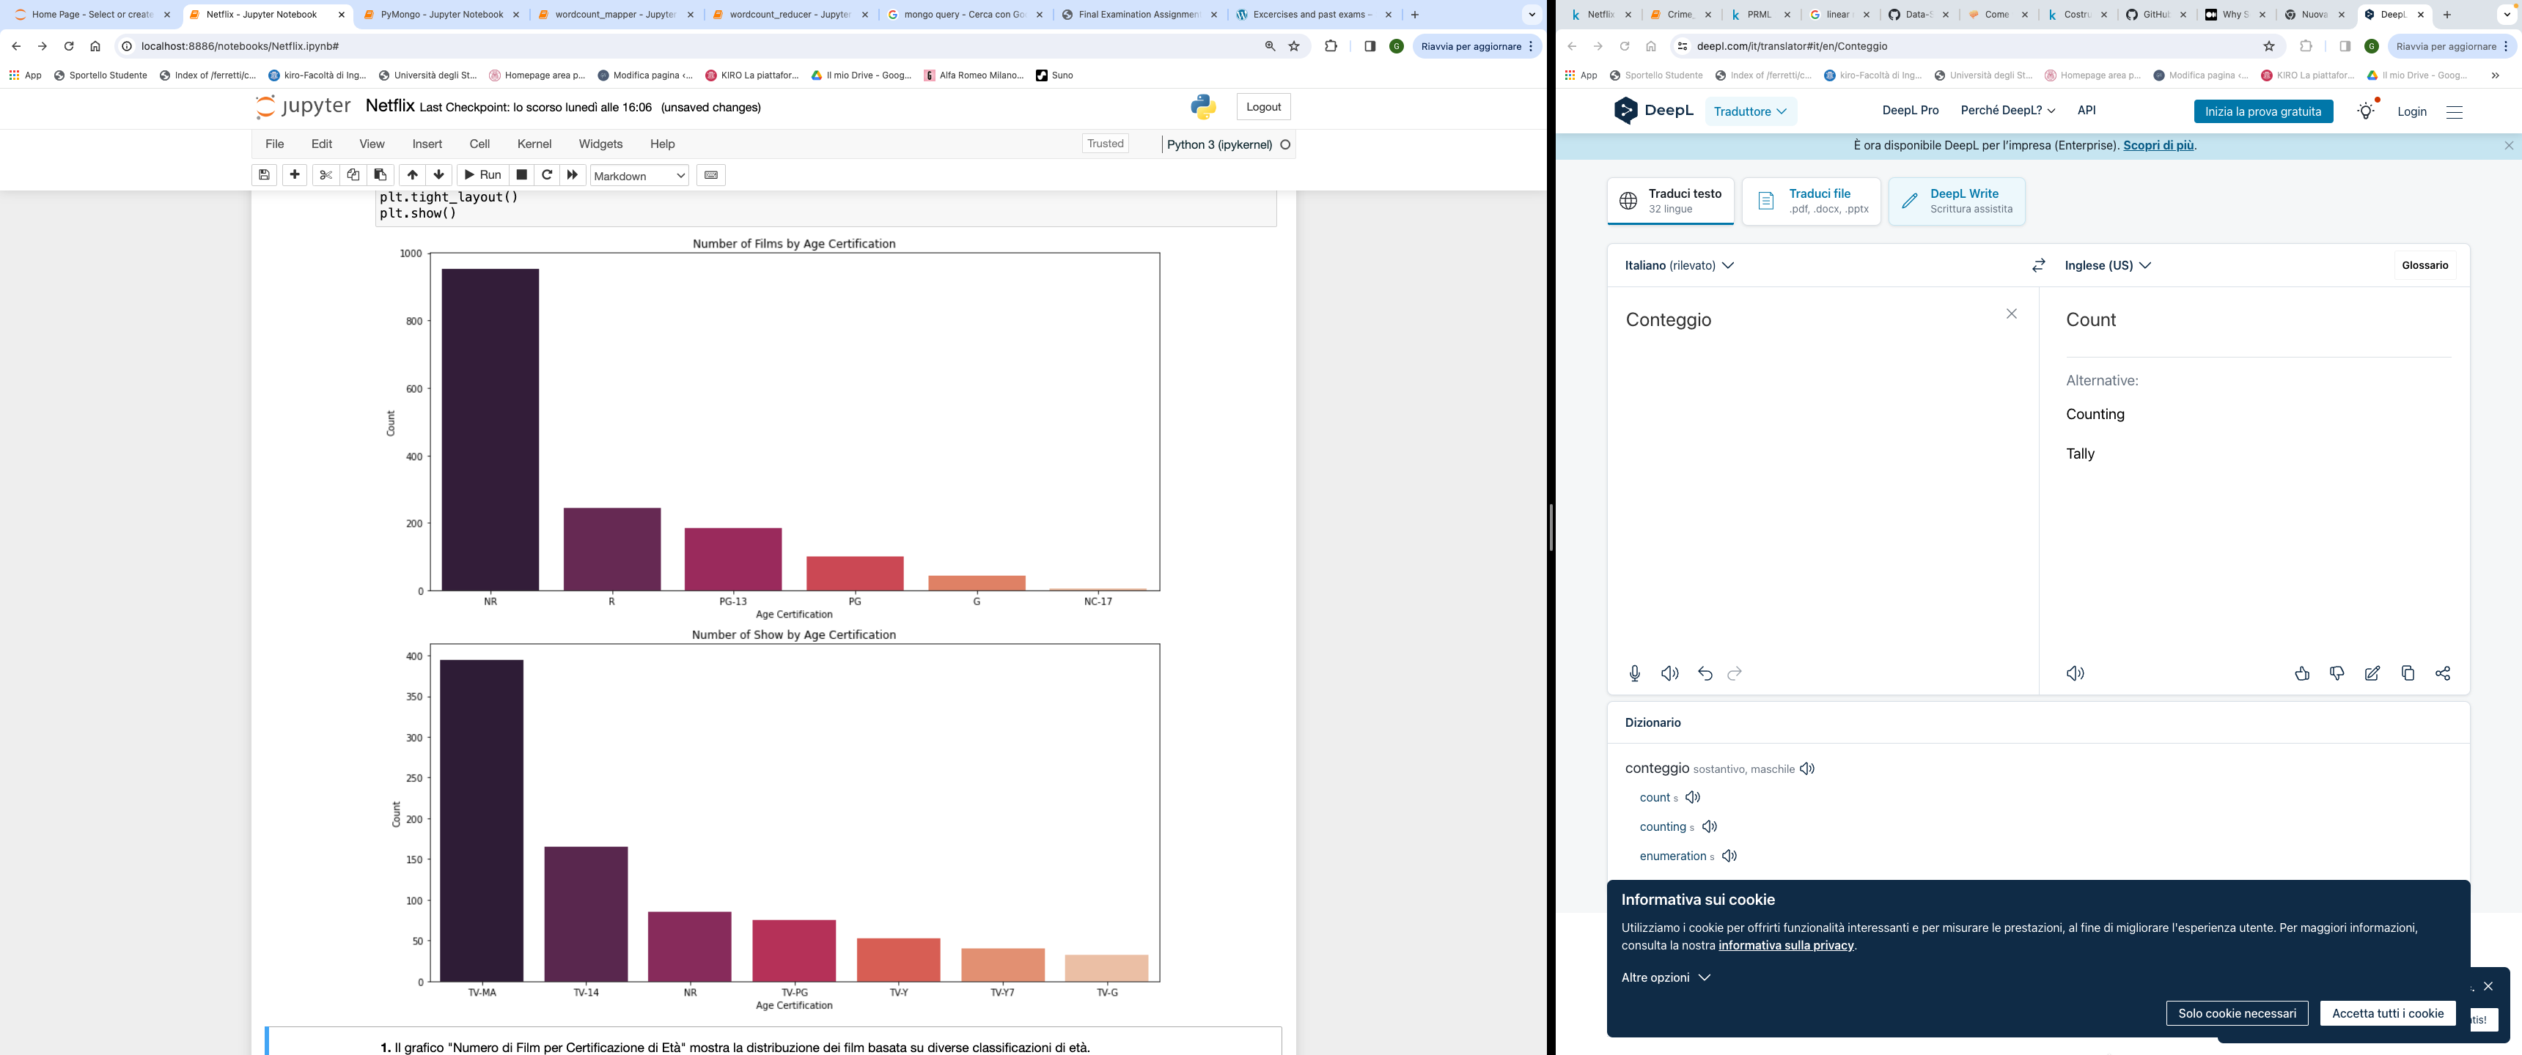
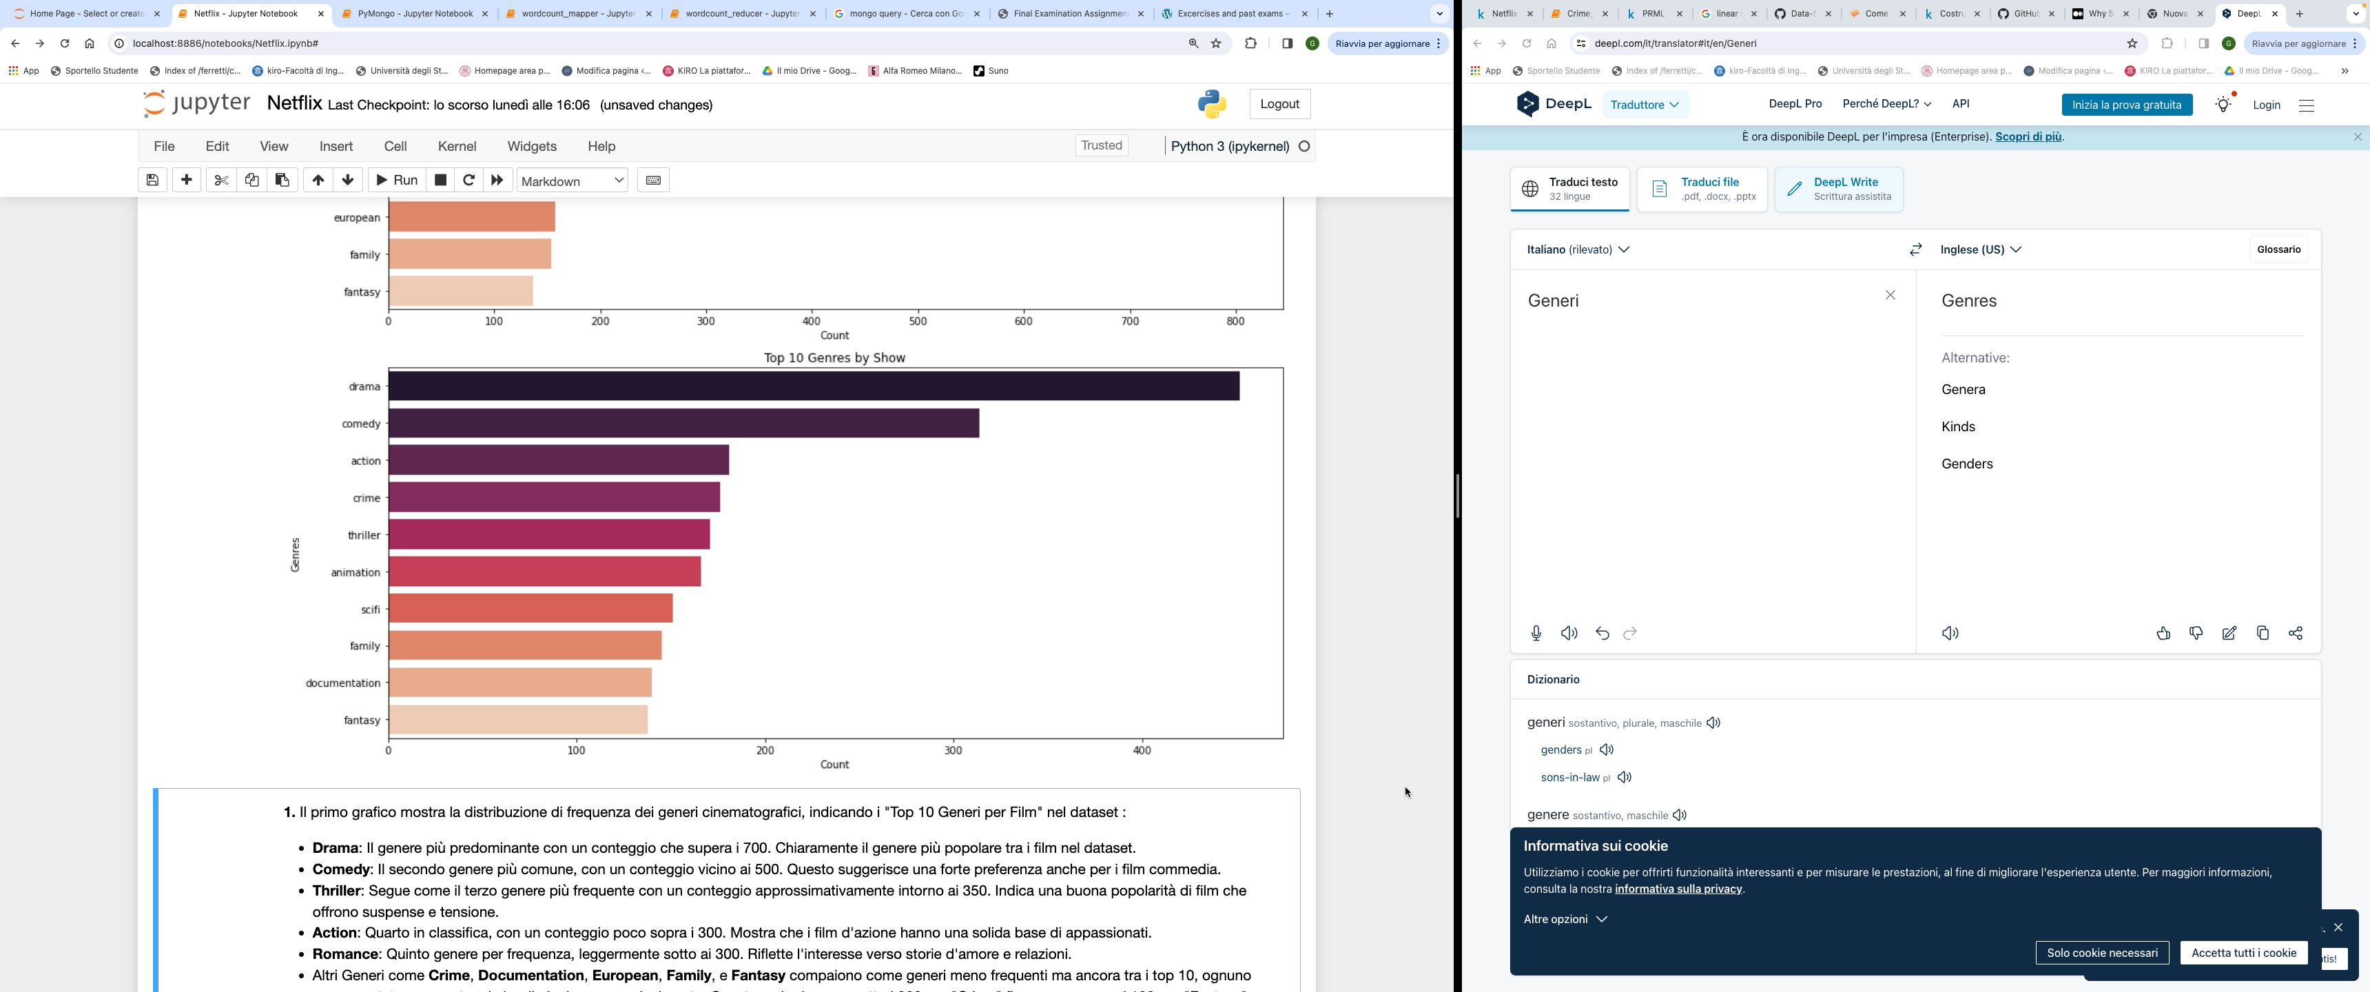
SANDBOX ANALYSIS
4
Exploratory Data Analysis and Visualization
We conducted an exploratory data analysis to understand the value distributions and uncover significant insights guiding further analysis. The visualizations helped identify trends and key relationships between variables, such as:
The dataframe shows a prevalence of movies over shows.
The most represented genre is "Drama", with the highest number of titles for both movies and shows.
The country with the highest number of produced titles is "United States" for both movies and shows.
The most common age certification is "TV-MA" for shows, while the majority of movies do not have an age certification.
Giuseppe Nato
Academic Year 2023/2024
492956

Slide 12
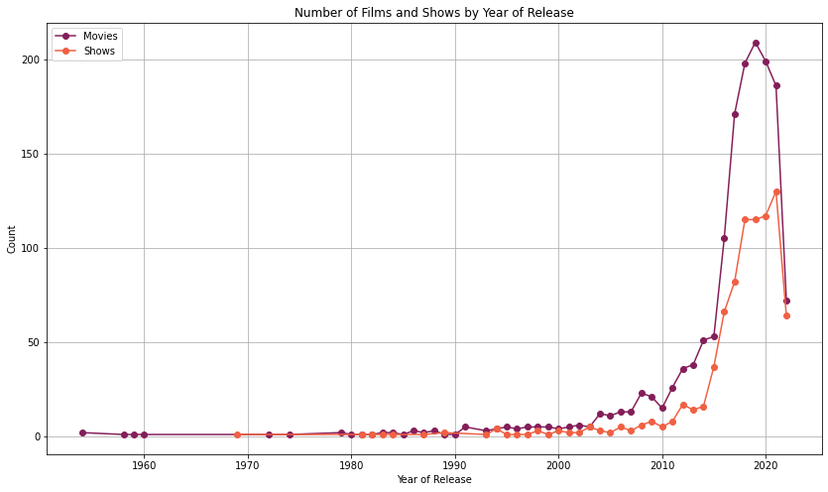
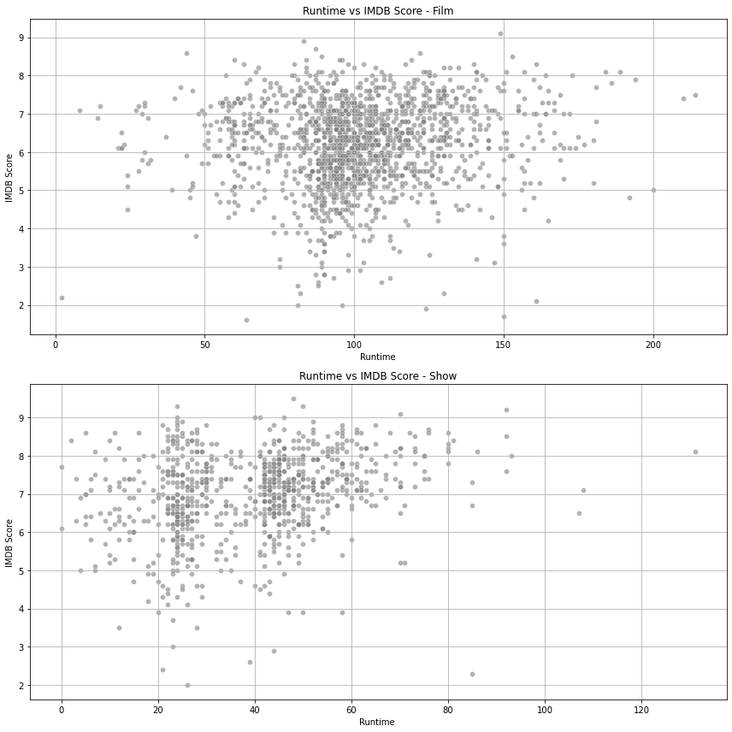
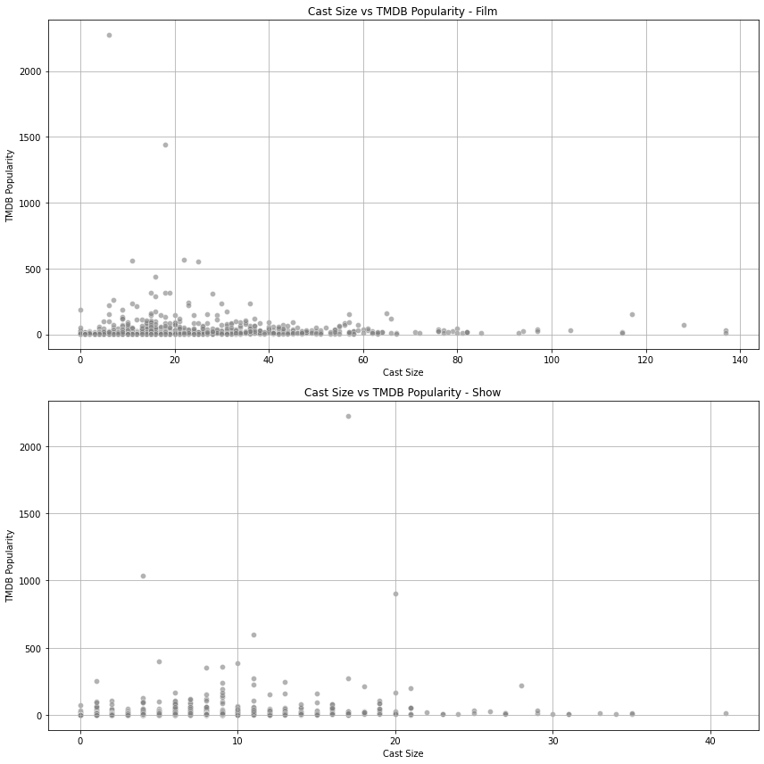
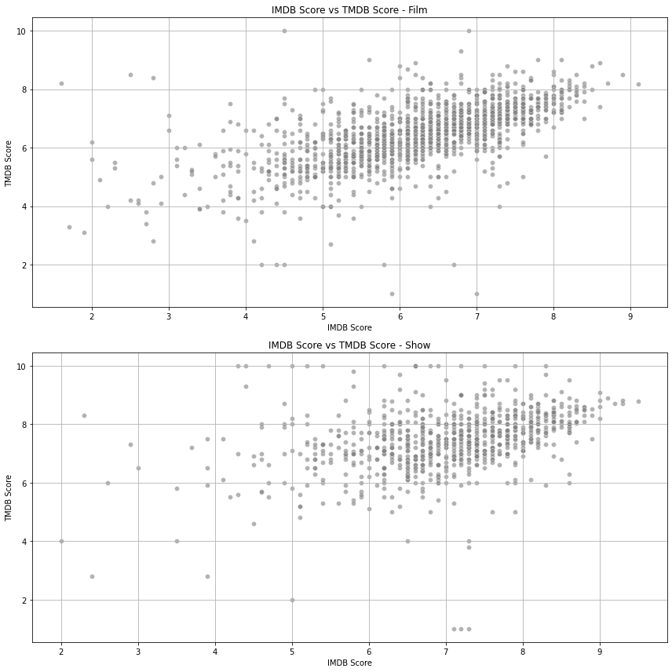
ANALYSIS SANDBOX
4
Exponential increase in the production of movies and TV shows from 2000 to 2019, followed by a marked decline in 2020 likely due to the COVID-19 pandemic
Movies with a duration between 90 and 130 minutes tend to have higher IMDb scores, while for TV shows, there is no strong correlation between episode duration and IMDb scores.
Popularity on TMDb is not strongly correlated with cast size for movies and TV shows, indicating that other factors influence success more significantly.
The charts show a positive correlation between IMDb and TMDb scores for movies and shows, with greater consistency for medium and high scores, but variability for low scores, suggesting that in the future, we might consider averaging the two scores for a more balanced evaluation.
Giuseppe Nato
Academic Year 2023/2024
492956

Slide 13
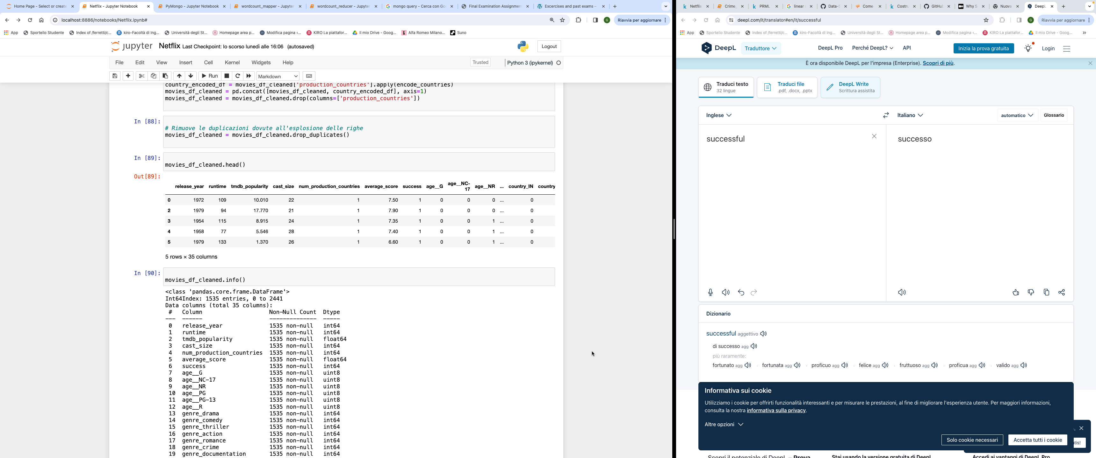
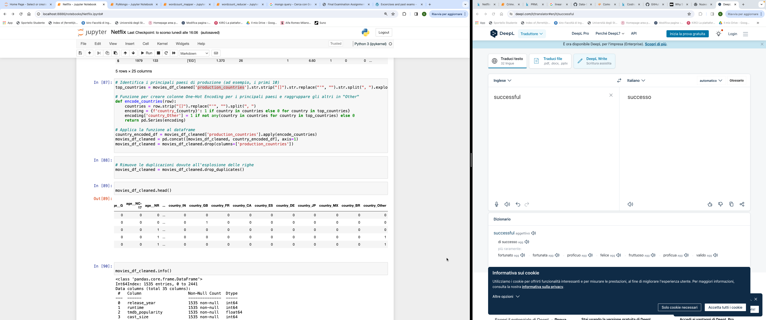
ANALYSIS SANDBOX
4
Feature Engineering and Transformation
We have filtered the dataframe to include only movies.
We removed the columns "type," "seasons," "description," "id," "title," "imdb_id," and "imdb_votes" from our dataset because they do not provide useful information for the analysis we intend to perform.
We created a new column called 'average_score' that represents the average of IMDb and TMDb scores for each movie, providing a single evaluation metric for each film
We created a binary variable called 'success' that identifies movies with an 'average_score' greater than or equal to 6.5 by assigning the value 1, while assigning the value 0 to movies with a lower score.
Categorical Variables
Age Certification: We performed a "one-hot encoding" operation on the 'age_certification' column to transform age certification categories into binary variables.
Genres and Production Countries: We identified the top 10 genres and production countries in the dataset and applied one-hot encoding to these values. Values not included in the top 10 were grouped into an "Other" category to avoid having too many dummy variables.
Giuseppe Nato
Academic Year 2023/2024
492956

Slide 14
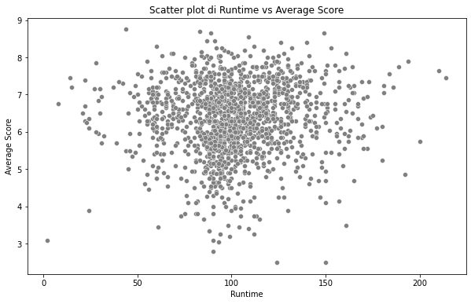
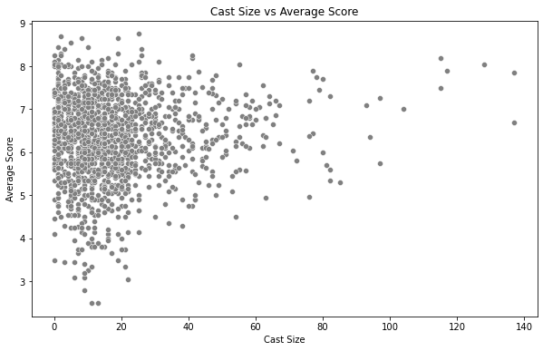
ANALYSIS SANDBOX
4
Hypothesis Testing with Visualization and Descriptive Analysis
H1: Movies with longer runtime tend to have higher scores
H2: Movies with larger casts are generally more highly rated
Correlation : 0.0654
P-value: 0.0104
Correlation : 0.0664
P-value: 0.0091
Most movies have average scores between 5 and 8 and runtime between 80 and 140 minutes, with a higher density between 90 and 120 minutes. The correlation between runtime and average score is 0.0654, indicating a very weak positive relationship, but it is statistically significant (p-value: 0.0104).
Although runtime is statistically significant, its effect on the average score is minimal. Thus, runtime is not a strong indicator of movie quality.
Most movies have a cast size of 0-20 members, with average scores between 5 and 8, and a higher density for cast sizes of 5-20 members with scores between 6 and 8. The correlation between cast_size and average_score is 0.0665, indicating a very weak positive relationship but statistically significant (p-value: 0.0092)
Although significant, the weak correlation suggests that cast size has minimal influence on average movie scores. Movies with larger casts (over 20 members) show a wide range of scores, indicating that other factors influence average scores.
Giuseppe Nato
Academic Year 2023/2024
492956

Slide 15
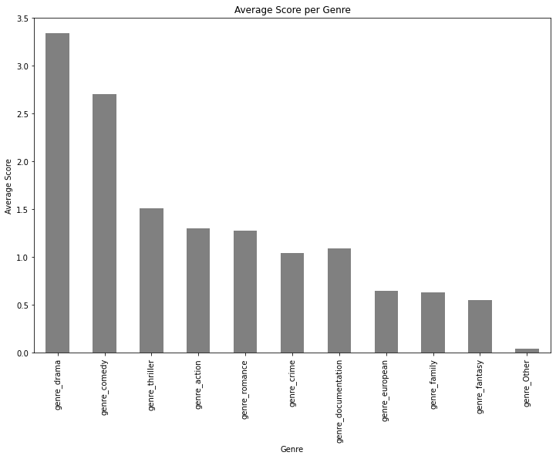
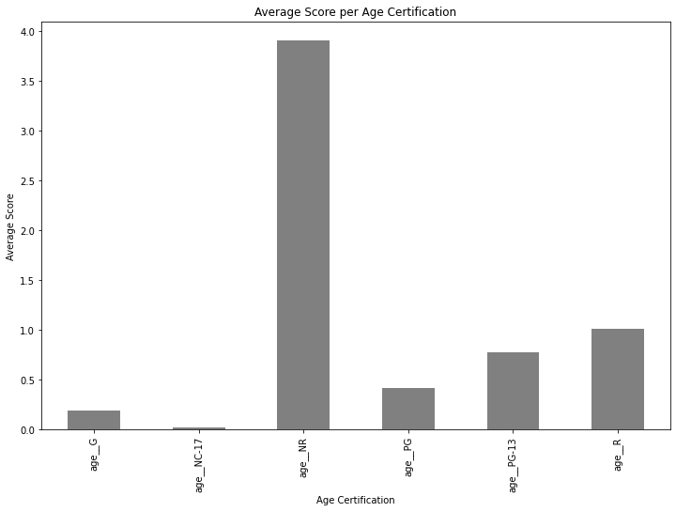
ANALYSIS SANDBOX
4
H3: Movies that include specific genres perform better in terms of scores
H4: Movies with more restrictive age certifications have higher scores
Dramatic and Comedy: Tend to have significantly higher average scores, supporting the hypothesis that including these genres can improve ratings.
Thriller, Action, Romance, Crime, Documentaries: Have lower average scores compared to dramas and comedies, but still variable, suggesting that other factors influence performance.
The hypothesis that movies of specific genres, particularly dramatic and comedy, perform better in terms of average scores is supported by the data.
Testing hypothesis H4 is complex, as many movies are not rated (NR - Not Rated). Considering this:
R (Restricted): Movies with an R rating have the highest average scores.
NC-17: Movies with an NC-17 rating have lower average scores.
G, PG, PG-13: Movies with less restrictive ratings tend to have lower average scores.
The hypothesis that more restrictive age certifications are associated with higher scores is supported for R-rated movies, but not for NC-17 rated movies.
Giuseppe Nato
Academic Year 2023/2024
492956

Slide 16
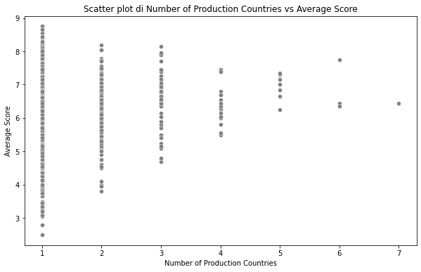
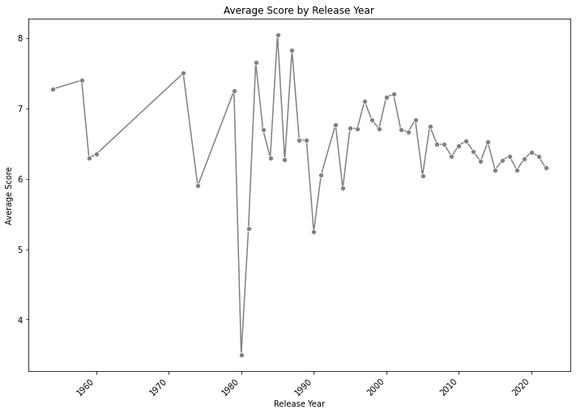
ANALYSIS SANDBOX
4
H5: Movies produced in multiple countries tend to have higher scores
H6: Newer movies have different rating trends compared to older movies, with possible annual variations.
Correlation: 0.049
P-value: 0.0527
Correlation: -0.0951
P-value: 0.0002
The correlation between the number of production countries and the average score is very weak and positive, and the p-value indicates that the correlation is not statistically significant.
There is not enough evidence to support the hypothesis that movies produced in multiple countries tend to have higher scores.
The scatter plot supports this conclusion, showing a scattered distribution of average scores relative to the number of production countries, without a clear upward trend.
Movies released before the 1980s tend to have higher average scores compared to newer movies, which show greater variability in average scores (4-8)
The correlation between release_year and average_score indicates a very weak but significant negative relationship considering the p-value.
Recent movies tend to have slightly lower scores compared to older movies, with greater variability in average scores. The hypothesis that newer movies have different rating trends is supported by the data.
Giuseppe Nato
Academic Year 2023/2024
492956

Slide 17
ANALYSIS SANDBOX
4
Hypothesis Testing with Inferential Analysis
To confirm the results of the descriptive analysis, we implemented a multivariate Linear Regression model using average_score as the dependent variable.
Implementation Steps:
We excluded the independent variables "age_NR" and "success" due to their high correlation.
The dataset was split into 80% for training and 20% for testing.
Continuous variables were transformed using the logarithmic function to normalize their distribution and then scaled using Min-Max Scaling.
Model training was done with cross-validation and evaluation on the test set.
Evaluation metrics used: MSE (Mean Squared Error) and R² .
Analysis of coefficients and p-values.
 | Train | Test
MSE | 0.7506 | 0.8737
R² | 0.1731 | 0.1371
Significant Variables | Coefficient | p-value
release_year | -1.1263 | 3.5806e-06
runtime | 1.0935 | 0.0148
tmdb_popularity | 0.6632 | 0.0030
genre_drama | 0.3250 | 2.8411e-07
genre_thriller | -0.3213 | 1.9753e-05
genre_action | -0.2119 | 0.0038
genre_romance | -0.2184 | 0.0017
genre_documentation | 0.8210 | 2.3271e-19
country_GB | 0.2962 | 0.0265
country_JP | 0.4432 | 0.0301
Result
The model has a rather low R² both on the training set (0.1731) and the test set (0.1371), suggesting that the model does not explain the variance in the data well. This may indicate that the model is too simple or that important factors are not included in the model.
Some variables such as release_year, runtime, tmdb_popularity, and various film genres show statistical significance, indicating that they have an impact, on the dependent variable. These variables can be considered important for the model.
Giuseppe Nato
Academic Year 2023/2024
492956

Slide 18
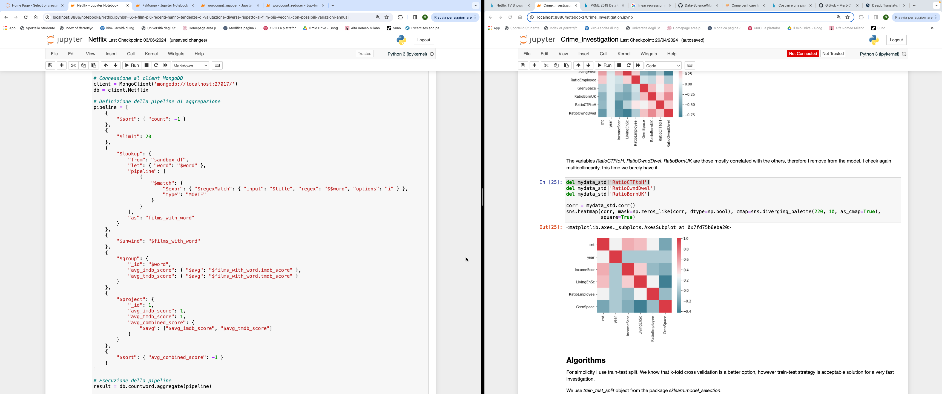
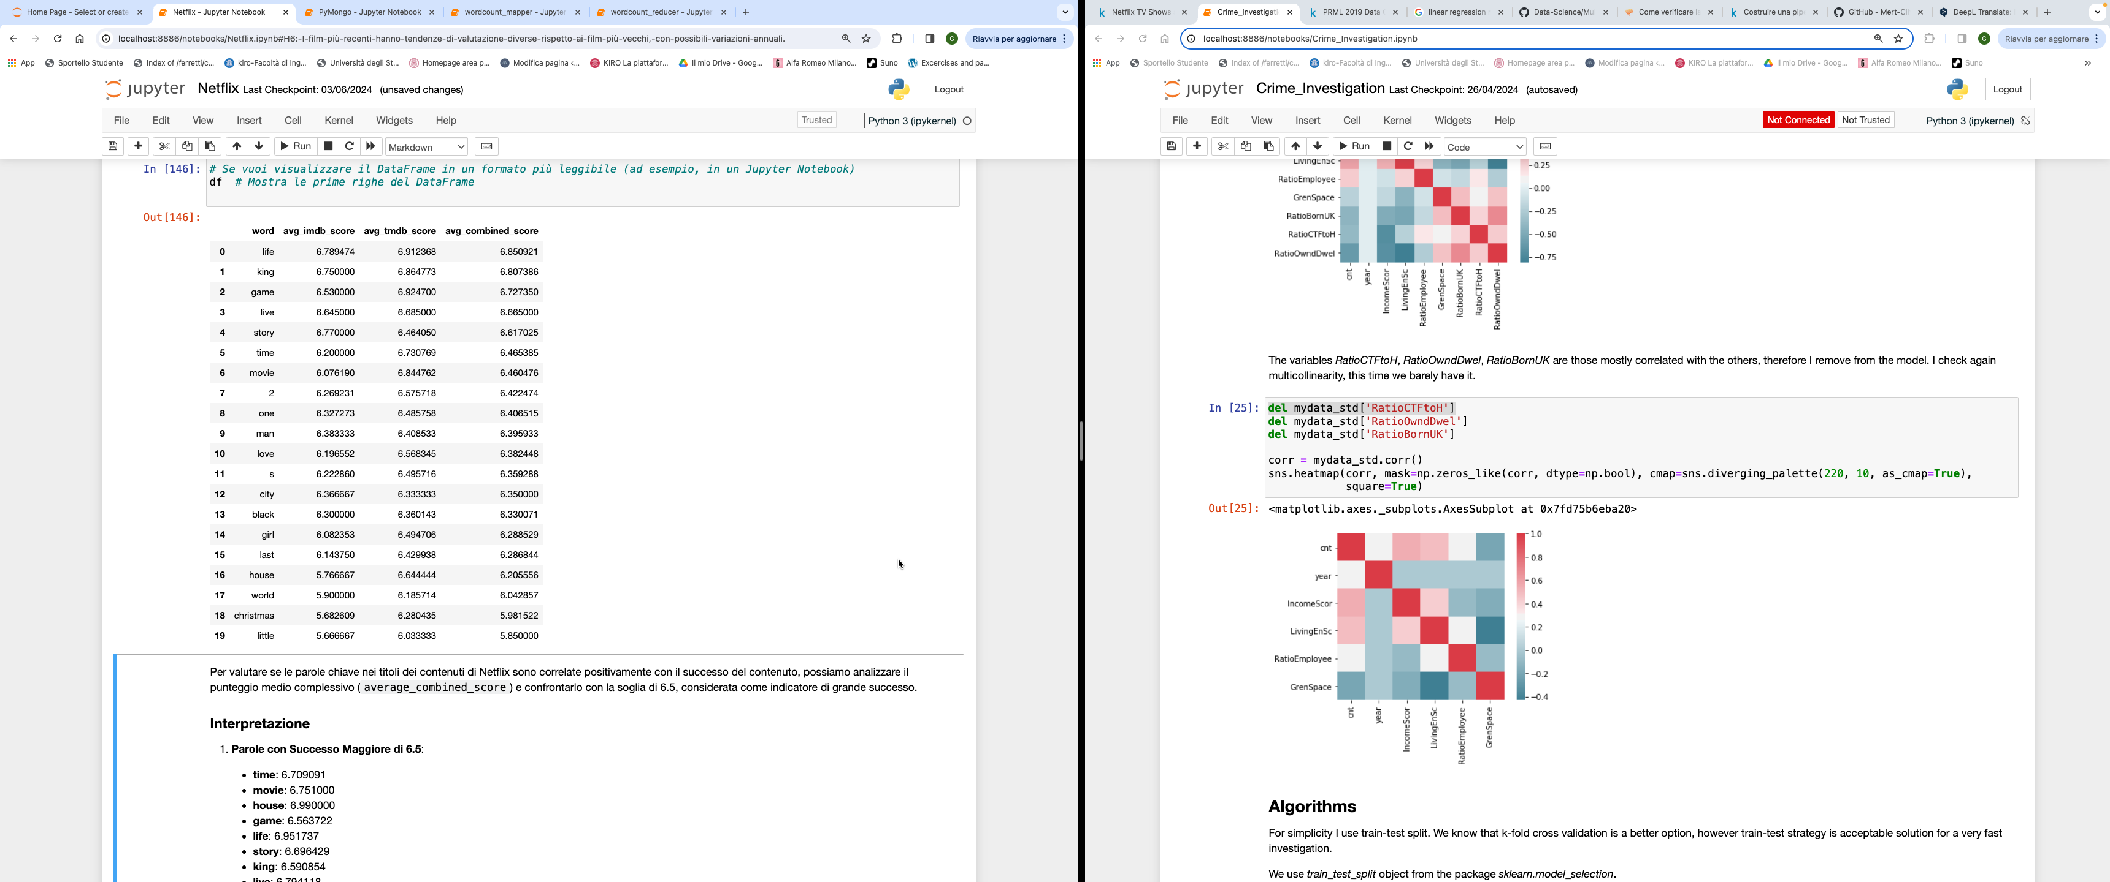
ANALYSIS SANDBOX
4
H7: The presence of certain keywords in the titles of Netflix content is positively correlated with the success of the content, as measured by the average score between IMDb score and TMDb score.
To test this hypothesis, we executed a MongoDB query using the output from the MapReduce job 'word_count'. This job calculated the occurrences of each word in movie titles, allowing us to determine if certain common words are correlated with the success of the movies.
The aggregation pipeline starts by sorting the documents in the "countword" collection by word count in descending order and limiting the results to the top 20.
Next, it joins these documents with the "sandbox_df" collection to get the movies containing the words in the titles and unpacks the array of movies to work with single documents.
Finally, the documents are grouped by keyword, and the average IMDb and TMDb scores are calculated, along with the combined average score, sorting the final results in descending order.
Certain keywords in movie titles such as "life," "king," and "game" can be correlated with success, measured through average IMDb and TMDb scores.
This analysis suggests that the use of specific keywords in titles could positively influence movie ratings.
Giuseppe Nato
Academic Year 2023/2024
492956

Slide 19
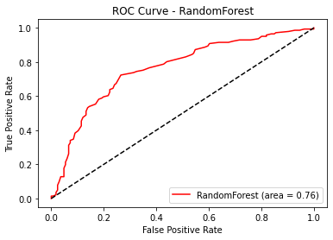
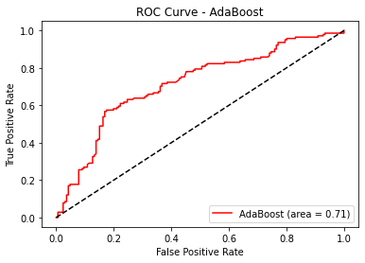
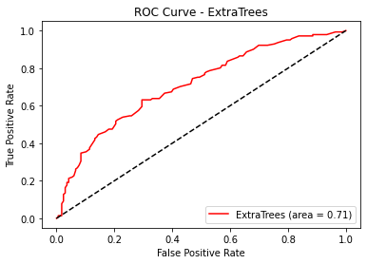
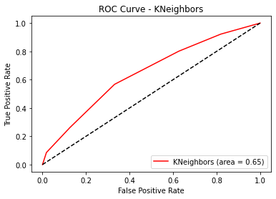
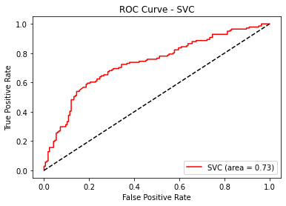
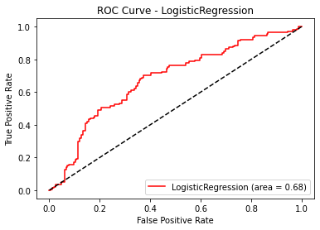

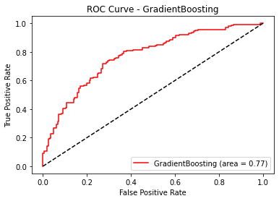
ANALYSIS SANDBOX
4
H8: The characteristics of a movie (runtime, genre, age certification, number of actors, IMDb score, popularity on TMDB, etc.) can be used to predict whether a movie will be successful or not.
To test this hypothesis, we implemented a classification model with the binary variable "success" as the dependent variable.
Model Selection
Giuseppe Nato
Academic Year 2023/2024
492956

Slide 20
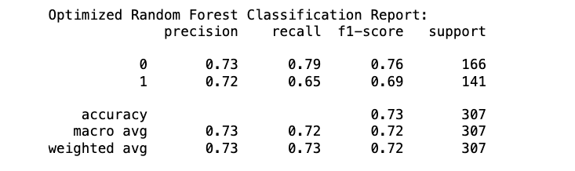
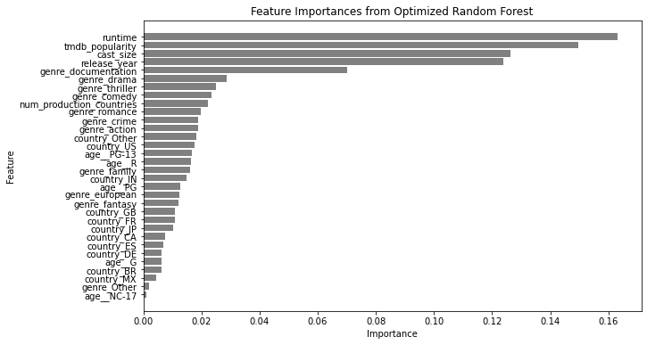
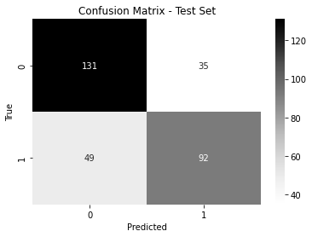
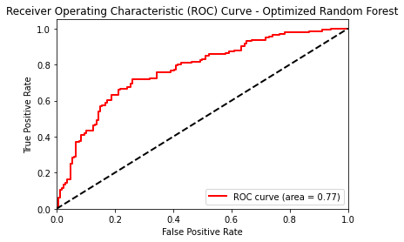
ANALYSIS SANDBOX
4
Optimized Random Forest
The optimized Random Forest model for testing hypothesis H8 shows a good ability to predict the success of films based on their characteristics.
The model's performance, with an accuracy of 73% and an AUC of 0.77, represents the best results obtained after optimization, suggesting that the selected features provide a solid basis for predicting a film's success.
The most influential features include runtime, TMDB popularity, and cast size.
Giuseppe Nato
Academic Year 2023/2024
492956

Slide 21
SPARK ANALYSIS
5
To ensure that the results obtained in the analysis sandbox are reliable and generalizable, we tested them on the entire dataset using PySpark and SparkML.
Linear regression
The implementation of the linear regression model using SparkML confirms the results obtained during the analysis sandbox. Although the model is not highly predictive, it was observed that some variables, such as the release year, runtime, and TMDB popularity, have a significant impact on movie scores. Specifically, hypotheses H1, H3, and H6 are confirmed by the model results, while hypotheses H2, H4, and H5 do not find complete support in the data.
Runtime: Films with longer runtime tend to have higher scores.
Specific Genres: Documentaries and dramas tend to have higher scores, while thrillers, action films, and comedies tend to have lower scores.
Release Year: More recent films tend to have lower scores.
Cast Size and Number of Production Countries: These do not have a significant impact on the scores.
H7: The most frequent words in movie titles that show an impact on their success, considering the entire dataset, are "life," "king," "game," "live," and "story." The results are aligned with those obtained in the analysis sandbox , confirming that these words are generally associated with movies with higher average scores. This confirms hypothesis H7.
Classification Model (H8)
The classification model that achieved the best results on the complete dataset was the Random Forest, showing consistent results with those obtained in the analysis sandbox . In particular, we found that certain variables also significantly influence the success of a movie in this case, such as runtime, cast size, TMDB popularity, and genre (especially documentaries). Additionally, the release year and production in specific countries like Japan, the United States, and India have a significant influence. However, the model's accuracy remains not very high, suggesting that there are other unconsidered factors that could influence a movie's success.
Giuseppe Nato
Academic Year 2023/2024
492956

Slide 22
RESULT AND CONCLUSION
6
The results obtained in our analysis have confirmed or refuted our hypotheses. Main finding:
H1. Movies with longer durations tend to have higher scores
Confirmed: Movies with longer durations tend to have higher scores.
H2. Movies with larger casts are generally rated higher.
Rejected: Although some movies with a very large cast achieve high scores, the correlation does not appear to be statistically significant.
H3. Movies that include specific genres (e.g., action or drama) perform better in terms of scores.
Confirmed: Certain specific genres, such as drama and documentary, perform better in terms of scores, while other genres like thriller, action, and romance tend to have lower scores. This confirms that some genres perform better
H4. Movies with more restrictive age certifications have higher scores.
Rejected: The results obtained do not confirm that movies with more restrictive age certifications (NC-17) have higher scores. Age certifications do not seem to have a significant impact on the average scores of movies, while less restrictive certifications like R and PG-13 have shown only a slight positive impact.
H5. Movies produced in multiple countries tend to have higher scores.
Rejected: The results obtained do not confirm the hypothesis that movies produced in multiple countries tend to have higher scores. The correlation is very weak and not statistically significant.
H6. More recent movies have different rating trends compared to older movies, with possible annual variations.
Confirmed: More recent movies tend to have slightly lower scores compared to older movies. The correlation is significant, and the graphs show variations in average annual scores. However, it should be noted that many more movies are being produced in recent years compared to the past.
Giuseppe Nato
Academic Year 2023/2024
492956

Slide 23
RESULT AND CONCLUSION
6
H7. The presence of certain keywords in the titles of Netflix movies is positively correlated with the success of the movie, measured based on the average score between IMDB and TMDB.
Confirmed: Our analysis has confirmed that movies with keywords in their titles such as "life", "king", "game", "live", and "story" achieve higher scores compared to movies that do not contain these words.
H8. The characteristics of a movie (duration, genre, age certification, number of actors, IMDb score, popularity on TMDB, etc.) can be used to predict whether a movie will be successful.
Confirmed: The analysis confirms that various characteristics of a movie can be effectively used to predict its success. In particular, the movie’s runtime, the number of actors, its popularity on TMDB, and certain genres (especially documentaries) play a crucial role in determining success.
Many of these insights can be useful for film producers and distributors in planning and promoting their projects.
Limitations
The linear regression model has several limitations. The results indicate that the model explains only a small portion of the variance in movie scores.
Similarly, the classification model shows accuracy that could be improved.
These results suggest that in both cases, we might have excluded important variables from the model.
Future Improvements
Better feature engineering and considering other forms of categorical variable encoding could improve the performance of the models.
Considering the use of more complex models could also help achieve better results.
Giuseppe Nato
Academic Year 2023/2024
492956

Slide 24

Giuseppe Nato
492956

